Slide 1
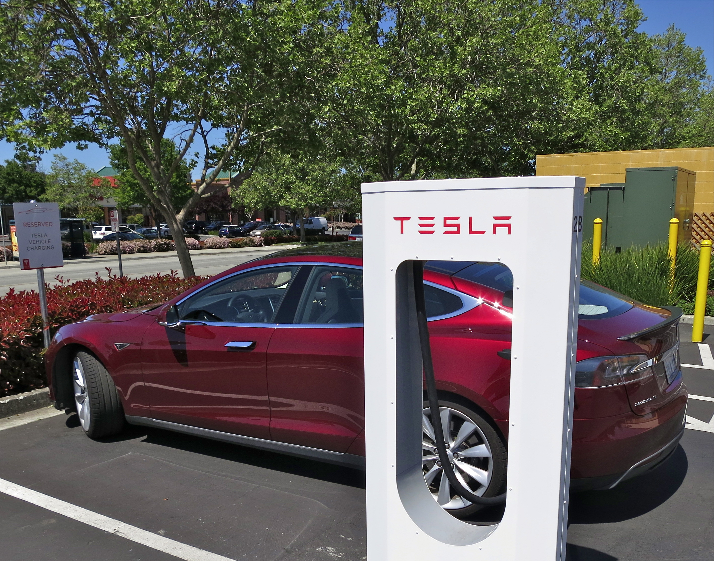
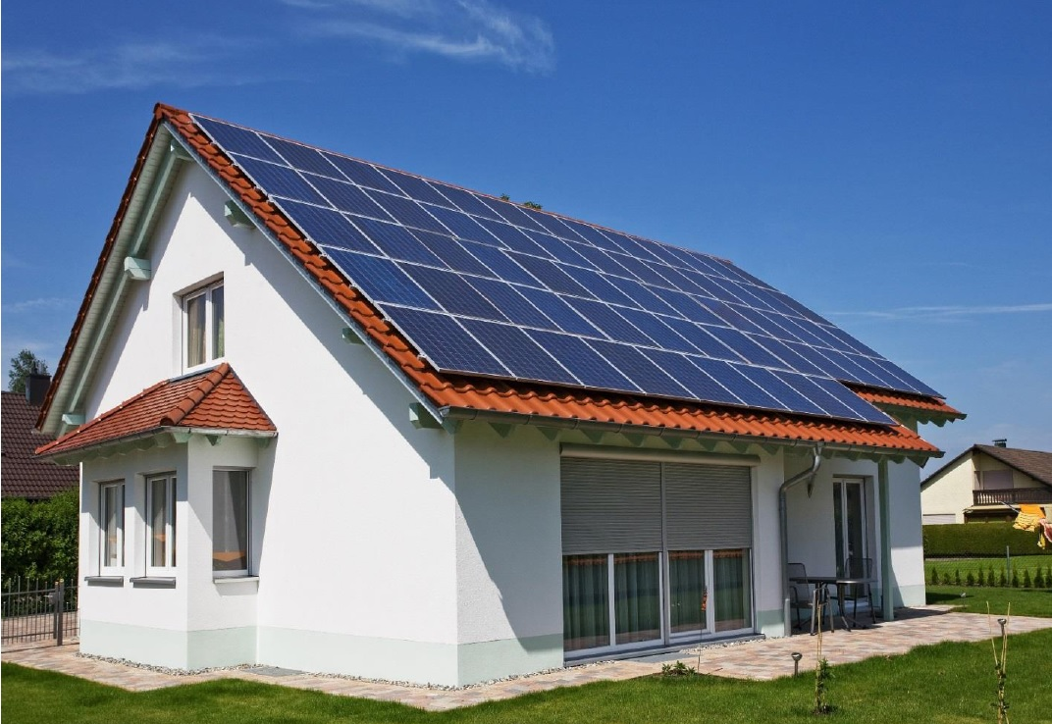
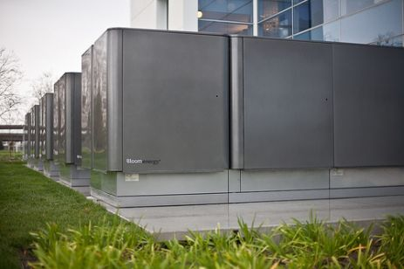
Valuing Distributed Energy Resources
The MIT Utility of the Future Study’s Approach
Jesse D. Jenkins – September 28, 2016
PJM Restructuring Roundtable, Philadelphia, PA

Slide 2
http://energy.mit.edu/research/utility-future-study/
Understanding how distributed energy resources are changing the provision of electricity services
1
Notes:
Since the days of Edison and Tesla, the history of the electric power system has largely been about scale: larger and larger power stations were developed to capture economies of unit scale and lower costs and larger and larger electricity transmission grids were constructed to leverage network economies of scale.
More recently, improvements in the cost and performance of distributed generation and storage technologies—as well as supportive public policies encouraging their adoption—may have the potential to reverse this trend and lead to a proliferation of smaller distributed resources. At the same time, improvements in information and communication technology have lowered transaction costs associated with demand response and aggregation and control of DERs.

Slide 3
THE MIT ENERGY INITIATIVE UTILITY OF THE FUTURE TEAM
Research Team
Ashwini Bharatkumar (MIT)
Michael Birk (MIT)
Scott Burger (MIT)
Dr. José Pablo Chaves (Comillas)
Dr. Cyril Draffin
Sam Huntington (MIT)
Jesse Jenkins (MIT)
Max Luke (MIT)
Dr. Paul McManus
Dr. Raanan Miller (MIT)
Dr. Richard Tabors (MIT)
Dr. Karen Tapia-Ahumada (MIT)
Dr. Claudio Vergara (MIT/Comillas)
Nora Xu (MIT)
Principal Investigators
Prof. Ignacio Pérez-Arriaga (MIT/Comillas)
Prof. Christopher Knittel (MIT)
Faculty Committee
Prof. Carlos Batlle (MIT/Comillas)
Prof. Michael Caramanis (BU)
Prof. John Deutch (MIT)
Prof. Tomas Gomez (Comillas)
Prof. William Hogan (Harvard)
Prof. Steven Leeb (MIT)
Prof. Richard Lester (MIT)
Prof. Les Norford (MIT)
Dr. John Parsons (MIT)
Prof. Richard Schmalensee (MIT)
2
Notes:
Since the days of Edison and Tesla, the history of the electric power system has largely been about scale: larger and larger power stations were developed to capture economies of unit scale and lower costs and larger and larger electricity transmission grids were constructed to leverage network economies of scale.
More recently, improvements in the cost and performance of distributed generation and storage technologies—as well as supportive public policies encouraging their adoption—may have the potential to reverse this trend and lead to a proliferation of smaller distributed resources. At the same time, improvements in information and communication technology have lowered transaction costs associated with demand response and aggregation and control of DERs.

Slide 4
KEY MESSAGES
The value of a distributed energy resource is highly dependent on the specific location of that resource in the power system.
“Locational value” can vary dramatically within a given power system.
The marginal value of DERs can decline rapidly as locational value is exhausted.
Efforts to define a single “value of solar” etc. will prove futile.
Economies of scale still matter. Smaller isn’t always better.
Only a cost-reflective system of prices and regulated charges (e.g. tariffs or rates) for electricity services will reveal the full value of DERs and unlock efficient opportunities for DER adoption.
3

Slide 5
1. LOCATIONAL AND NON-LOCATIONAL VALUES
 | Locational | Non-locational
Power system values | Energy Network capacity margin Network constraint mitigation Power quality Reliability and resiliency Black-start | Firm generation capacity Operating reserves Price hedging
Other values | Land use Employment Premium values* | Emissions mitigation Energy security
 | * Private values; do not need to be reflected in prices and charges
4

Slide 6
2. LOCATIONAL VALUE VARIES DRAMATICALLY
More than three quarters of nodes between $21-40/MWh
Approximately 3 percent of nodes
with very high locational value, 3-10 times the average
5
Notes:
The most congested node in PJM has an average congestion price of $26/MWh, but 93% of nodes have an average congestion price between -$5/MWh and $5/MWh.

Slide 7
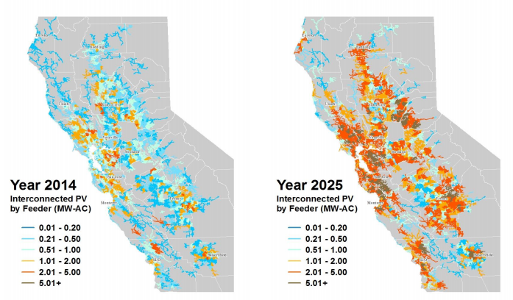
2. LOCATIONAL VALUE VARIES DRAMATICALLY
Expected Solar PV Growth by Feeder in California ISO system
Network capacity benefits of distributed solar PV in California
(Cohen, Kauzmann & Callaway, 2016)
90% of feeders:
$0/kW-yr (zero)
10% of feeders:
$10/kW-yr to $60/kW-yr
1% of feeders:
>$60/kW-yr
See: M.A. Cohen, P.A. Kauzmann, D.S. Callaway, Effects of distributed PV generation on California’s distribution system, part 2: Economic analysis, Solar Energy, Volume 128, 2016, 139–152
6
Notes:
The most congested node in PJM has an average congestion price of $26/MWh, but 93% of nodes have an average congestion price between -$5/MWh and $5/MWh.

Slide 8
3. MARGINAL VALUE DECLINES
7
Notes:
The most congested node in PJM has an average congestion price of $26/MWh, but 93% of nodes have an average congestion price between -$5/MWh and $5/MWh.

Slide 9
3. MARGINAL VALUE DECLINES
Expected Solar PV Growth by Feeder in California ISO system
Network capacity benefits of distributed solar PV in California
(Cohen, Kauzmann & Callaway, 2016)
Distribution network capacity deferral benefit falls by 50% as solar PV penetration increases to 10% of annual energy (assume 20% capacity factor)
See: M.A. Cohen, P.A. Kauzmann, D.S. Callaway, Effects of distributed PV generation on California’s distribution system, part 2: Economic analysis, Solar Energy, Volume 128, 2016, 139–152
8
Notes:
The most congested node in PJM has an average congestion price of $26/MWh, but 93% of nodes have an average congestion price between -$5/MWh and $5/MWh.

Slide 10
4. NO SINGLE “VALUE OF SOLAR” OR OTHER DERS
9
Notes:
The most congested node in PJM has an average congestion price of $26/MWh, but 93% of nodes have an average congestion price between -$5/MWh and $5/MWh.

Slide 11
4. NO SINGLE “VALUE OF SOLAR” OR OTHER DERS
Note order of magnitude change in y-axis scale
10
Notes:
The most congested node in PJM has an average congestion price of $26/MWh, but 93% of nodes have an average congestion price between -$5/MWh and $5/MWh.

Slide 12
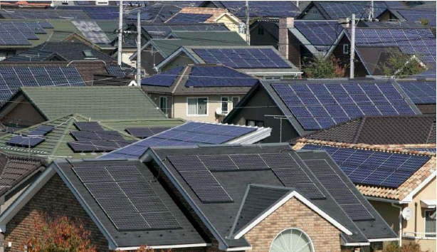
5. ECONOMIES OF SCALE STILL MATTER
11
Notes:
The unit costs (typically measured in dollars per MW) of technologies that exhibit economies of unit scale fall as the technology is installed at larger scales (e.g. a 500 MW system may cost less per MW than a 5 MW system). Economies of unit scale are well documented for generating technologies. These economies of scale were a major driver of the vertically integrated utility regulatory paradigm, and their perceived exhaustion was a major driver for liberalization of wholesale electricity markets.

Slide 13
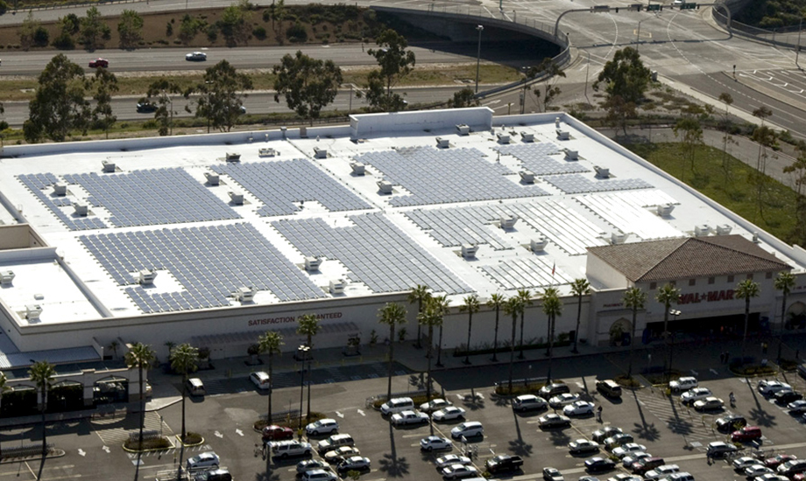
5. ECONOMIES OF SCALE STILL MATTER
11
Notes:
The unit costs (typically measured in dollars per MW) of technologies that exhibit economies of unit scale fall as the technology is installed at larger scales (e.g. a 500 MW system may cost less per MW than a 5 MW system). Economies of unit scale are well documented for generating technologies. These economies of scale were a major driver of the vertically integrated utility regulatory paradigm, and their perceived exhaustion was a major driver for liberalization of wholesale electricity markets.

Slide 14
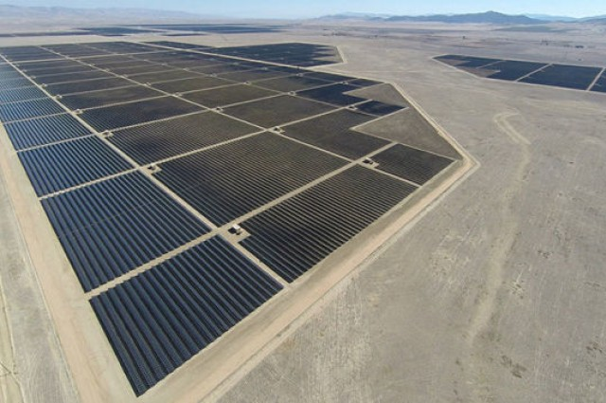
5. ECONOMIES OF SCALE STILL MATTER
11
Notes:
The unit costs (typically measured in dollars per MW) of technologies that exhibit economies of unit scale fall as the technology is installed at larger scales (e.g. a 500 MW system may cost less per MW than a 5 MW system). Economies of unit scale are well documented for generating technologies. These economies of scale were a major driver of the vertically integrated utility regulatory paradigm, and their perceived exhaustion was a major driver for liberalization of wholesale electricity markets.

Slide 15
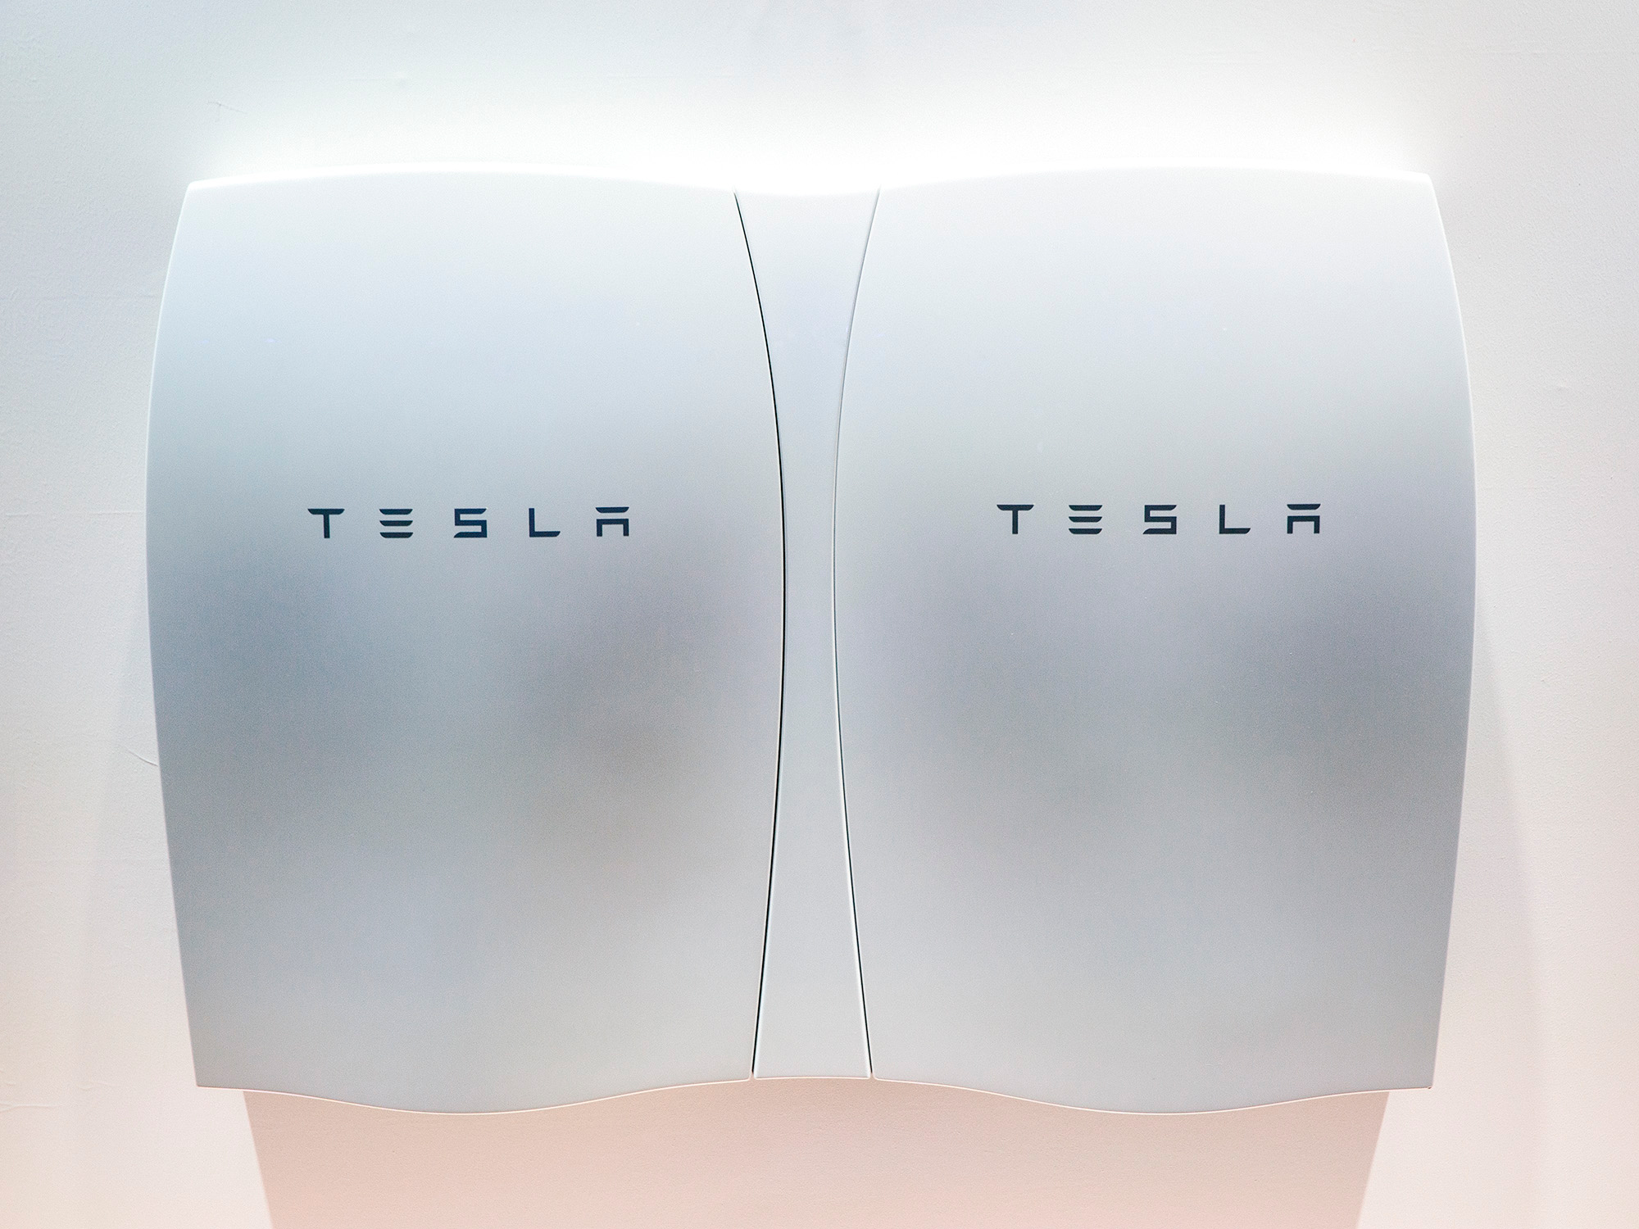
5. ECONOMIES OF SCALE STILL MATTER
12

Slide 16
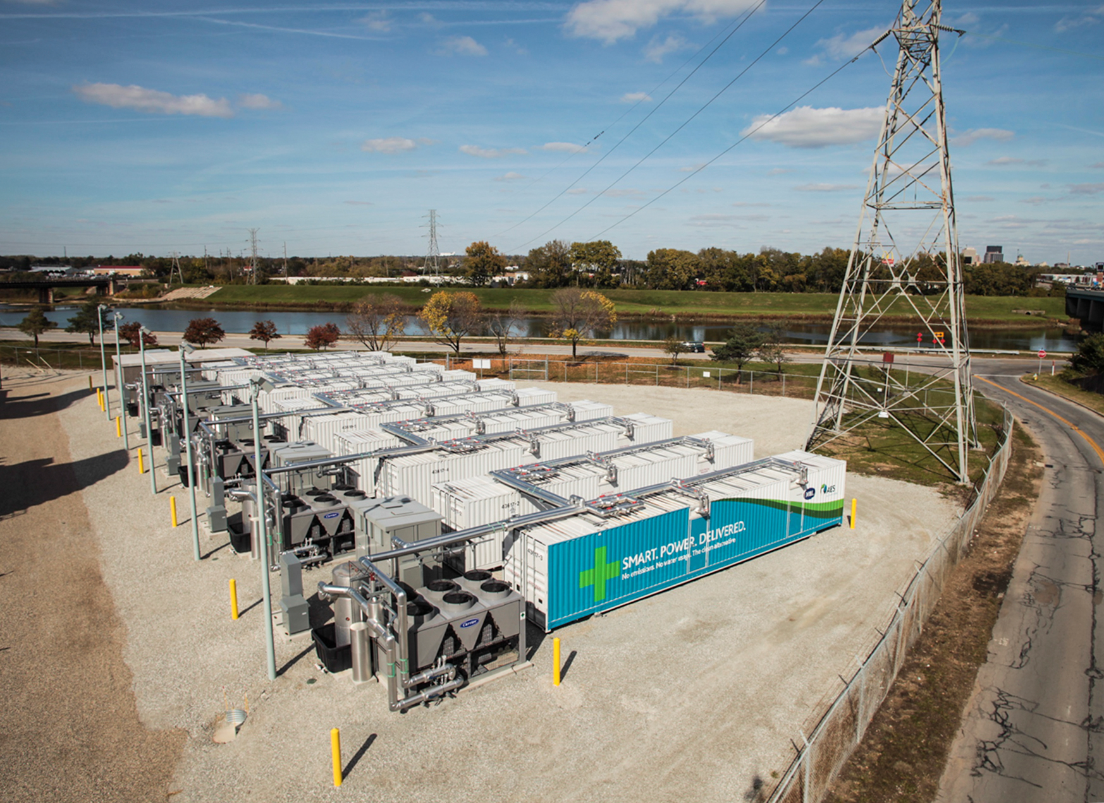
5. ECONOMIES OF SCALE STILL MATTER
12

Slide 17
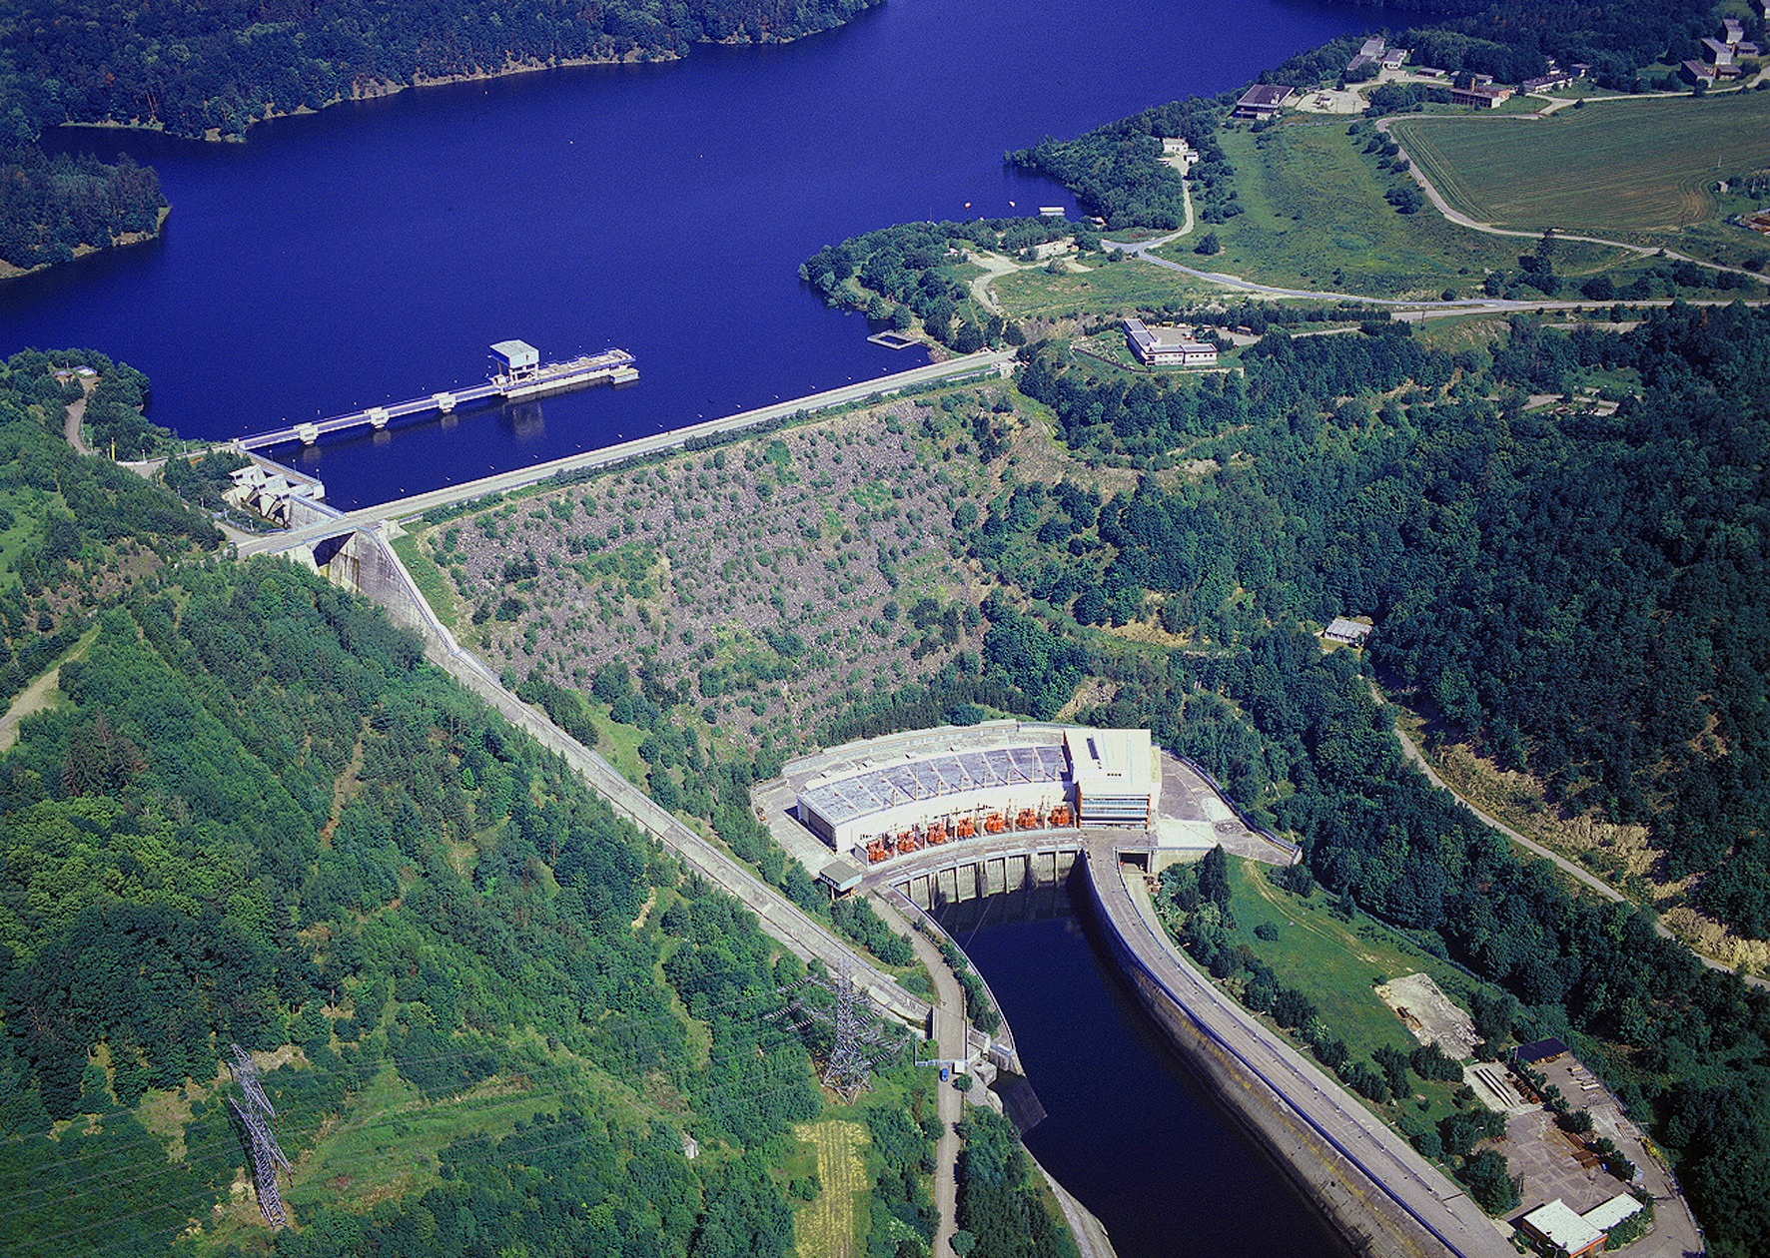
5. ECONOMIES OF SCALE STILL MATTER
12

Slide 18
5. ECONOMIES OF SCALE STILL MATTER
Sources: Installed system costs, fixed O&M, and project lifespan from Lazard (2015), “Lazard’s Levelized Cost of Energy Analysis, Version 9.0.” PV output profiles from NREL PVWatts for New York, NY (distributed projects: 14.6% capacity factor) and White Plains, NY (for utility-scale, single-axis tracking: 17.3% capacity factor). 7% weighted average cost of capital applied.
13
Notes:
The unit costs (typically measured in dollars per MW) of technologies that exhibit economies of unit scale fall as the technology is installed at larger scales (e.g. a 500 MW system may cost less per MW than a 5 MW system). Economies of unit scale are well documented for generating technologies. These economies of scale were a major driver of the vertically integrated utility regulatory paradigm, and their perceived exhaustion was a major driver for liberalization of wholesale electricity markets.

Slide 19
5. ECONOMIES OF SCALE STILL MATTER
Locational Value
Distributed Opportunity Costs
14
Notes:
The most congested node in PJM has an average congestion price of $26/MWh, but 93% of nodes have an average congestion price between -$5/MWh and $5/MWh.

Slide 20
5. ECONOMIES OF SCALE STILL MATTER
Locational Value
Distributed Opportunity Costs
15
Notes:
The most congested node in PJM has an average congestion price of $26/MWh, but 93% of nodes have an average congestion price between -$5/MWh and $5/MWh.

Slide 21
6. COST-REFLECTIVE PRICES AND CHARGES NEEDED
To unlock the full value of DERs and put all resources on a level playing field, electricity prices, charges, and other incentives need to become much more sophisticated, capturing the marginal locational value of DERs with sufficient temporal and locational granularity.
16

Slide 22
6. COST-REFLECTIVE PRICES AND CHARGES NEEDED
Granularity matters:
Prices and regulated charges for electricity services can vary significantly at different times and in different locations in the grid. Progressively improving the temporal and locational granularity of prices and charges can deliver increased efficiency, although these benefits must be balanced against the costs and complexity of implementation.
Hourly wholesale LMPs
Extend LMPs into meshed part of distribution networks
Wholesale LMP + marginal distribution loss value
Active power LMPs for all locations in network
Active and reactive power LMPs for all locations in network
Time-varying rates w/critical peak prices
Options for increasing granularity of energy prices
17

Slide 23
6. COST-REFLECTIVE PRICES AND CHARGES NEEDED
(2) Price the peaks for all network users:
Peak-coincident capacity charges that reflect a users’ contribution to network use at times of peak demand and injection, as well as scarcity-coincident generating capacity charges, can unlock flexible demand and distributed resources and enable significant price savings.
18

Slide 24
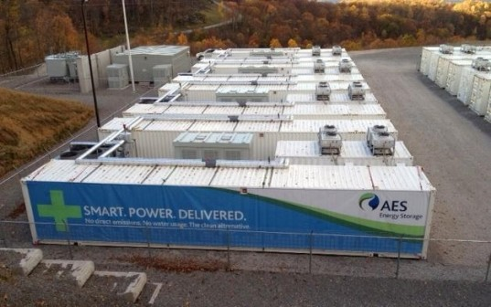
6. COST-REFLECTIVE PRICES AND CHARGES NEEDED
(3) Avoid distortions from charges to collect residual network costs and costs of public purpose programs or policies:
Charges to recover these costs should be minimally distortive. Customer fixed charges are a good option, but regulators must be wary of the possibility of “grid defection” if fixed charges become too high. This may suggest an upper limit on the sum of these costs that can be collected in electricity tariffs.
19

Slide 25
http://energy.mit.edu/research/utility-future-study/
Stay tuned, Q4 2016…
1
Notes:
Since the days of Edison and Tesla, the history of the electric power system has largely been about scale: larger and larger power stations were developed to capture economies of unit scale and lower costs and larger and larger electricity transmission grids were constructed to leverage network economies of scale.
More recently, improvements in the cost and performance of distributed generation and storage technologies—as well as supportive public policies encouraging their adoption—may have the potential to reverse this trend and lead to a proliferation of smaller distributed resources. At the same time, improvements in information and communication technology have lowered transaction costs associated with demand response and aggregation and control of DERs.

Slide 26
Questions

